Slide 1
STAT41130: AI for Weather and Climate
Andrew Parnell

Slide 2
Course Introduction
Quick round table (who are you, and what would you like to get out of this course?)
Inspiration for this course:
AI by Hand by Tom Yeh: www.byhand.ai
StatQuest ‘Clearly Explained’ Videos
Artificial Intelligence Forecasting System (AIFS),
Anemoi: https://github.com/ecmwf/anemoi-core
This is a hands-on course, mixing manual calculation and coding
Weather and climate is a motivating application, but the ideas can be applied more widely

Slide 3
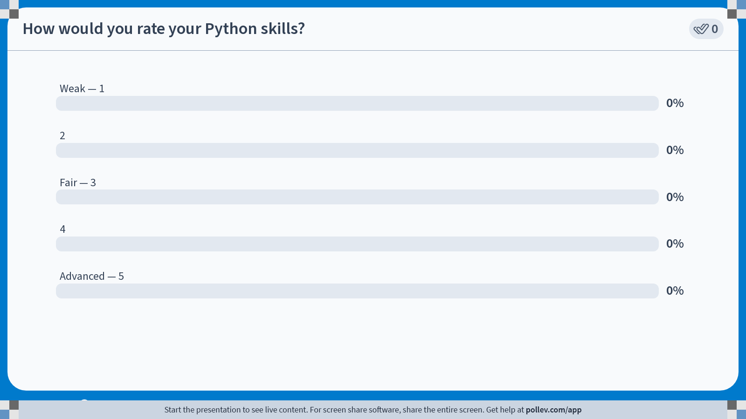
Notes:
Do not modify the notes in this section to avoid tampering with the Poll Everywhere activity. More info at polleverywhere.com/support How would you rate your Python skills?
https://www.polleverywhere.com/multiple_choice_polls/ke0F7V1qXKkGTR3kaJFc2?state=opened&flow=Default&onscreen=persist

Slide 4

Notes:
Do not modify the notes in this section to avoid tampering with the Poll Everywhere activity. More info at polleverywhere.com/support How would you rate your Machine Learning / AI skills?
https://www.polleverywhere.com/multiple_choice_polls/hWsbco8TWVs02D6zeGQK2?state=opened&flow=Default&onscreen=persist

Slide 5
Github repo
All information at: https://github.com/andrewcparnell/STAT41130
Contains slides (PPT files), code (Python script files), and worksheets (PDFs).
To access the material either:
Use git directly to download the materials
Go to the website and click: Code -> Download Zip
If you find typos/bugs either:
Let me know (basic)
File an issue on the GitHub page (intermediate)
Create a Pull Request and fix it yourself (advanced, and most helpful)

Slide 6
Taking for credit
If taking for credit the breakdown will be:
60% exam
30% daily presentations
10% for answering quizzes
Each day is structured the same: 2 lectures, some quizzes, some coding in the afternoon, presentation at the end of the day
You will be in different groups each day
Google Drive link to put all the material

Slide 7
Setup
Best if you have Ubuntu or similar Linux running on your computer
Look at the setup folder in the Github repo
We can go through how to set this up
Use VS code for coding
Install the requirements in one (or more) of the requirements_*.txt files

Slide 8
Aims of this course this course
Learn to build and evaluate ML models for weather forecasting for use in your research
01
Understand what the models are doing in the background so that you can extend them
02
Work with real meteorological datasets from e.g. the Climate Data Store
03

Slide 9

Who is this course for?
Designed for students with either AI or weather/climate background
No deep prior experience in either area required
Collaboration across disciplines is strongly encouraged
Lots of interaction and group work
Main expert tools you need are:
$×$and $+$

Slide 10
Structure of course
4 + 4 days:
2 ~1-hour lectures in the morning
Short introduction to coding challenges
2-3 hour self-guided group exercises in the afternoon
Presentations at the end of the day
Computing labs use PyTorch
Lectures start from assuming no knowledge about NNs
Expect to create short presentations, coding tasks, and pen-and-paper exercises
Green text means we go to the board

Slide 11
Syllabus (week 1)
Linear regression and neural networks
NNs and back-propagation
Deep learning
Convolutional NNs
Recurrent NNs
Transformers
Graph NNs
Probabilistic forecasting with NNs

Slide 12
Syllabus (week 2)
Graph Convolutional Neural Networks
SERT
Overview – data-driven weather forecasting
AIFS / Anemoi
Other topics (if time):
Bayesian inference
Github
Overleaf

Slide 13
Class 1: Linear regression to neural networks

Slide 14
Learning outcomes
Reminder of linear regression (LR)
How to fit linear regression models
Thinking about LR as a neural network
Fitting LR like a neural network

Slide 15
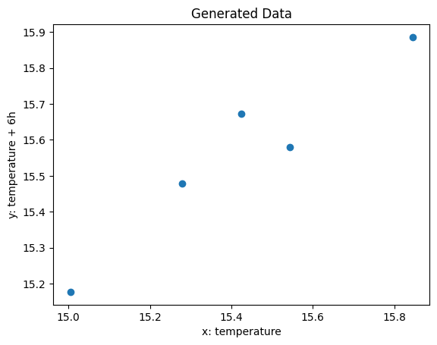
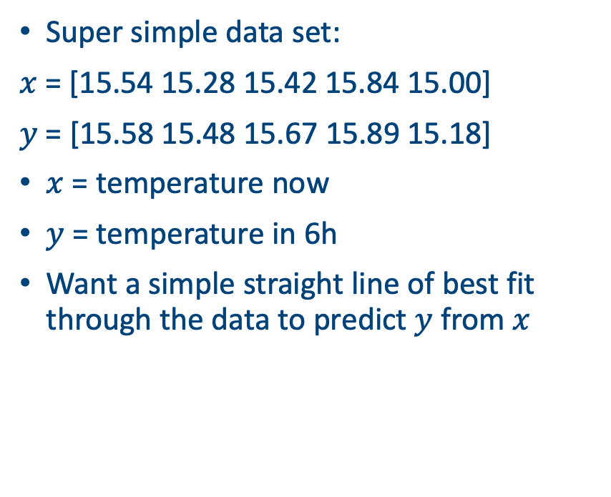
Drawing straight lines of best fit
Super simple data set:
$x$ = [15.54 15.28 15.42 15.84 15.00]
$y$ = [15.58 15.48 15.67 15.89 15.18]
$x$ = temperature now
$y$ = temperature in 6h
Want a simple straight line of best fit through the data to predict $y$ from $x$

Slide 16
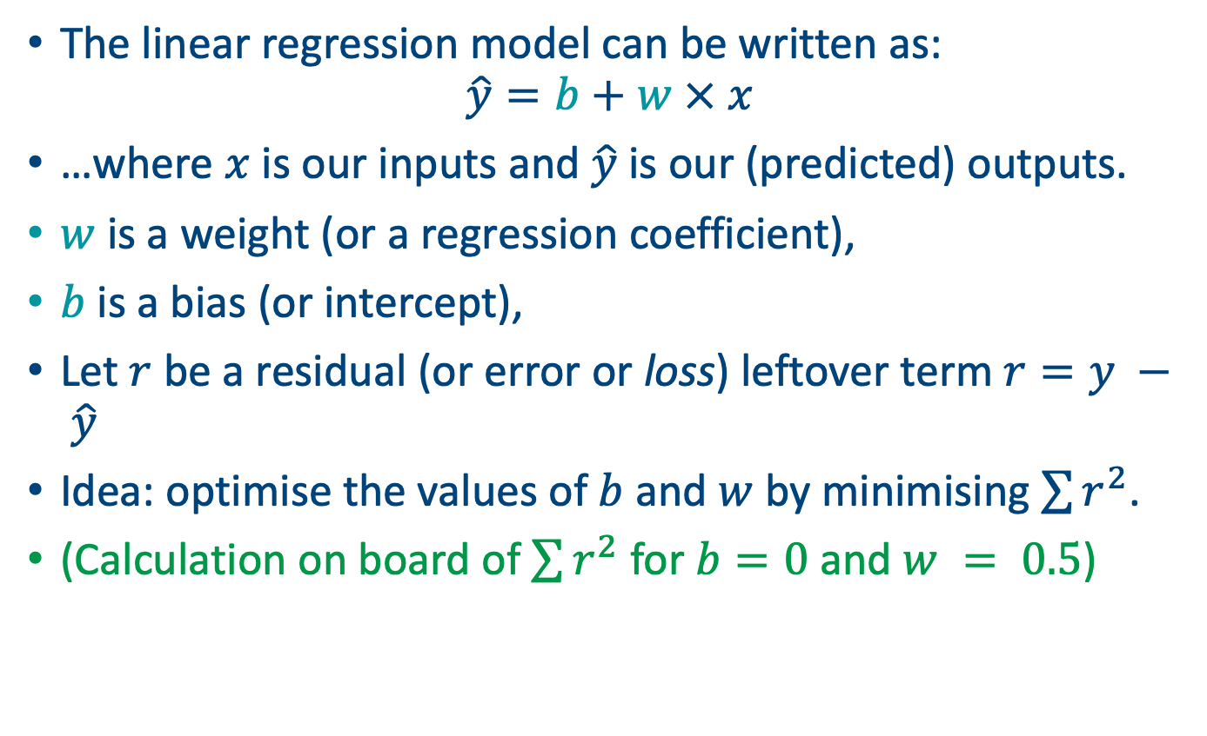
Foundations of linear regression
The linear regression model can be written as:
$$\hat{y}=b+w × x$$
…where $x$ is our inputs and $\hat{y}$is our (predicted) outputs.
$w$ is a weight (or a regression coefficient),
$b$ is a bias (or intercept),
Let $r$ be a residual (or error or loss) leftover term $r=y − \hat{y}$
Idea: optimise the values of $b$ and $w$ by minimising $\sum{r^{2}}$.
(Calculation on board of $\sum{r^{2}}$ for $b=0$ and $w = 0.5$)

Slide 17
Python example
b = 1
w = 1
loss = np.sum((y - (b + w * X)) ** 2)
# Loss for b=1, w=1: 3.74
b = 5
w = 0.5
loss = np.sum((y - (b + w * X)) ** 2)
Loss for b=5, w=0.5: 40.65

Slide 18
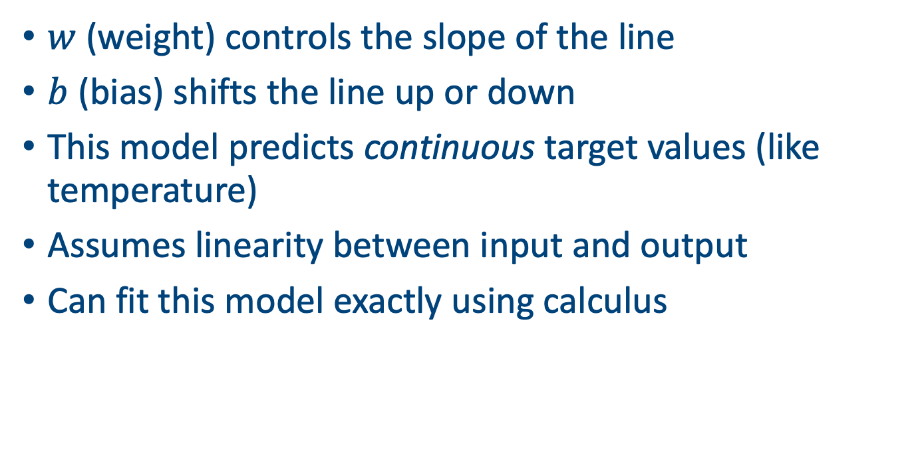
More intuition
$w$ (weight) controls the slope of the line
$b$ (bias) shifts the line up or down
This model predicts continuous target values (like temperature)
Assumes linearity between input and output
Can fit this model exactly using calculus

Slide 19
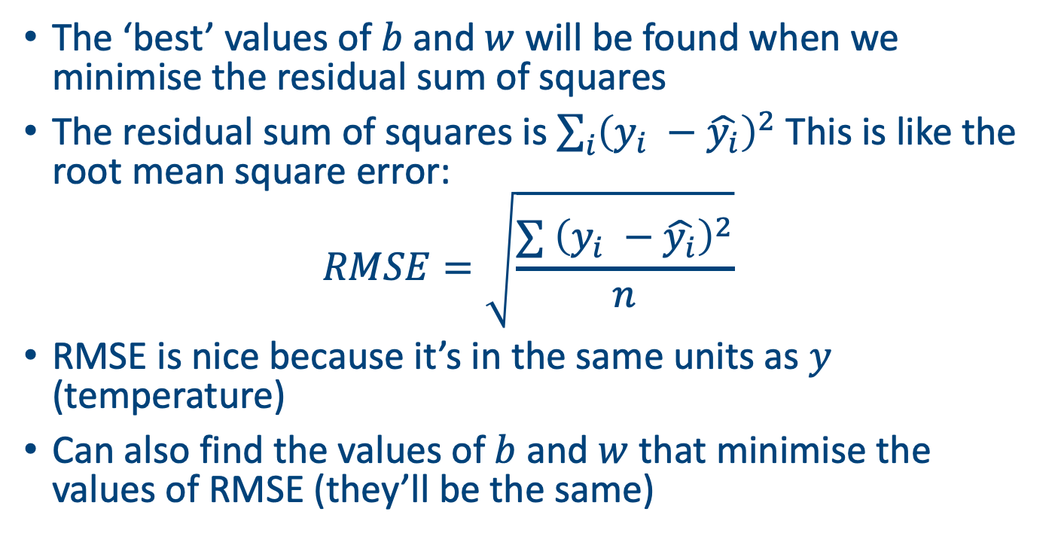
The loss function
The ‘best’ values of $b$ and $w$ will be found when we minimise the residual sum of squares
The residual sum of squares is $\sum_{i}{{\left(y_{i} −\hat{y_{i}}\right)}^{2} }$This is like the root mean square error:
$$RMSE=\sqrt{\frac{∑{ \left(y_{i} −\hat{y_{i}}\right)}^{2}}{n}}$$
RMSE is nice because it’s in the same units as $y$ (temperature)
Can also find the values of $b$ and $w$ that minimise the values of RMSE (they’ll be the same)

Slide 20
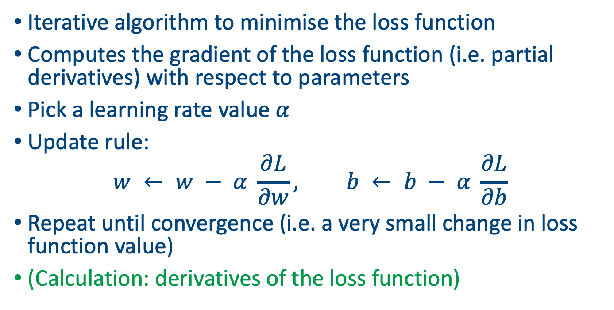
Solution via gradient descent
Iterative algorithm to minimise the loss function
Computes the gradient of the loss function (i.e. partial derivatives) with respect to parameters
Pick a learning rate value $α$
Update rule:
$$w ← w − α \frac{∂L}{∂w}, b ← b − α \frac{∂L}{∂b}$$
Repeat until convergence (i.e. a very small change in loss function value)
(Calculation: derivatives of the loss function)

Slide 21
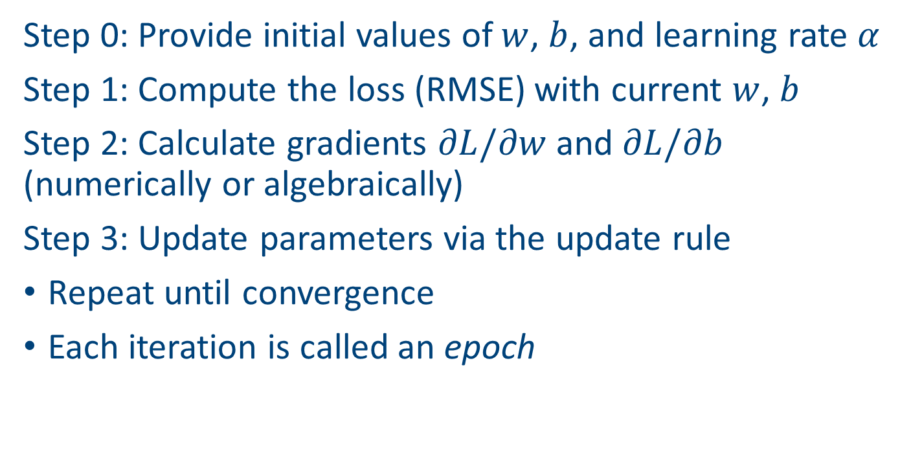
Algorithm
Step 0: Provide initial values of $w$, $b$, and learning rate $α$
Step 1: Compute the loss (RMSE) with current $w$, $b$
Step 2: Calculate gradients $∂L/∂w$and $∂L/∂b$ (numerically or algebraically)
Step 3: Update parameters via the update rule
Repeat until convergence
Each iteration is called an epoch

Slide 22
In action
w, b = 0.0, 0.0
alpha = 0.01
epochs = 100
losses = []
for epoch in range(epochs):
dw, db = compute_gradients(X, y, w, b)
w -= lr * dw
b -= lr * db
loss = rmse(y, predict(X, w, b))
if epoch % 10 == 0:
print(f'Epoch {epoch}, Loss: {loss:.4f}, w: {w:.4f}, b: {b:.4f}')
losses.append(loss)

Slide 23
In action
Epoch 0, Loss: 9.0256, w: 1.4669, b: 1.9654
Epoch 1, Loss: 4.7143, w: 1.1885, b: 1.9474
Epoch 2, Loss: 2.4623, w: 1.0431, b: 1.9380
Epoch 3, Loss: 1.2860, w: 0.9671, b: 1.9330
Epoch 4, Loss: 0.6715, w: 0.9274, b: 1.9305
Epoch 5, Loss: 0.3506, w: 0.9067, b: 1.9291
Epoch 6, Loss: 0.1829, w: 0.8959, b: 1.9284
Epoch 7, Loss: 0.1006, w: 0.8902, b: 1.9281
Epoch 8, Loss: 0.0732, w: 0.8873, b: 1.9279
Epoch 9, Loss: 0.0667, w: 0.8857, b: 1.9278

Slide 24
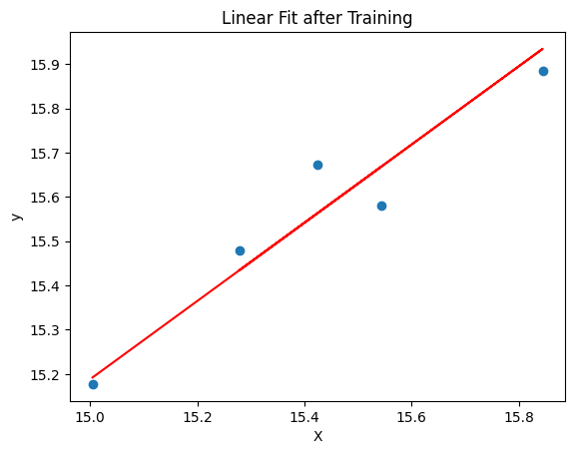
Plotting the fit

Slide 25
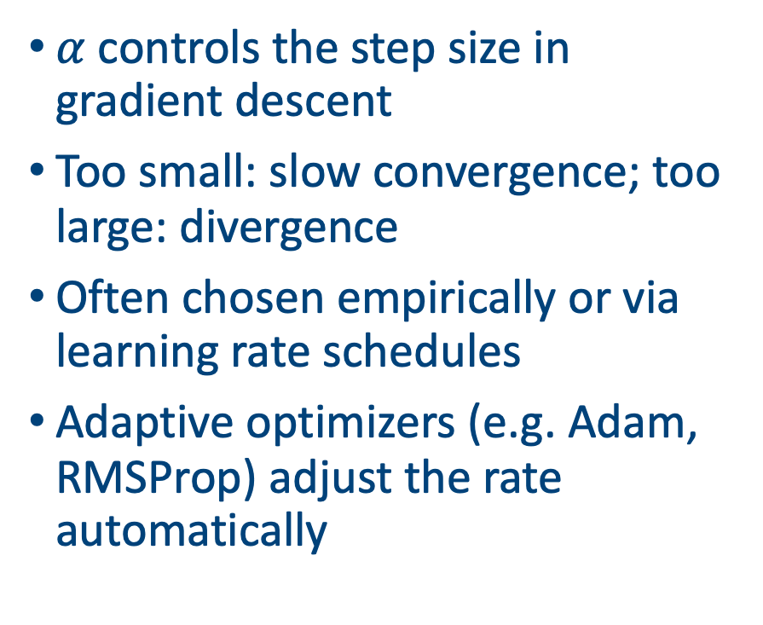
Learning rate
$α$ controls the step size in gradient descent
Too small: slow convergence; too large: divergence
Often chosen empirically or via learning rate schedules
Adaptive optimizers (e.g. Adam, RMSProp) adjust the rate automatically

Slide 26
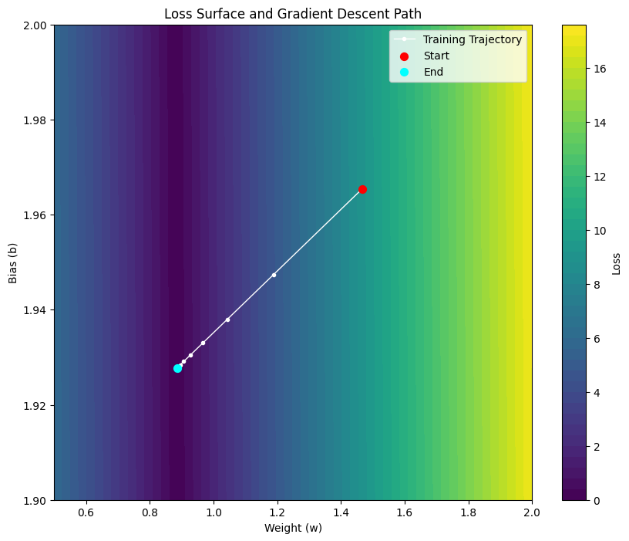
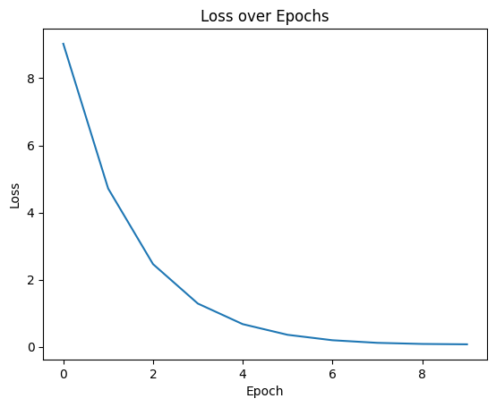
Parameter trajectories

Slide 27
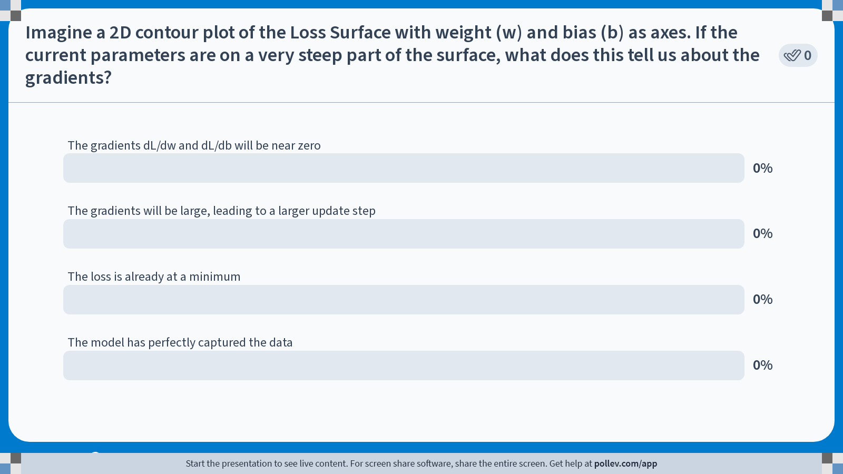
Notes:
Do not modify the notes in this section to avoid tampering with the Poll Everywhere activity. More info at polleverywhere.com/support Imagine a 2D contour plot of the Loss Surface with weight (w) and bias (b) as axes. If the current parameters are on a very steep part of the surface, what does this tell us about the gradients?
https://www.polleverywhere.com/multiple_choice_polls/Nl64SB8F6W7j9Limp1MDf?state=opened&flow=Default&onscreen=persist

Slide 28
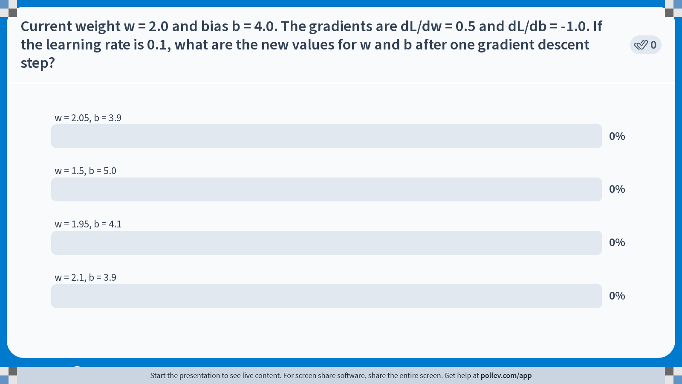
Notes:
Do not modify the notes in this section to avoid tampering with the Poll Everywhere activity. More info at polleverywhere.com/support Current weight w = 2.0 and bias b = 4.0. The gradients are dL/dw = 0.5 and dL/db = -1.0. If the learning rate is 0.1, what are the new values for w and b after one gradient descent step?
https://www.polleverywhere.com/multiple_choice_polls/OrixocTkLIB9GXI5DFJxH?state=opened&flow=Default&onscreen=persist

Slide 29
Batch vs stochastic gradient descent
Batch GD: uses entire dataset each iteration; smooth but computationally heavy
Stochastic GD: updates using fewer (or just one) samples; faster but noisy
Mini‑batch GD: compromise between the two
Noise in SGD can help escape shallow minima
Notes:
$w_{new} = 2.0 - (0.1 \times 0.5) = 1.95$
$b_{new} = 4.0 - (0.1 \times -1.0) = 4.1$

Slide 30
Training and testing
Common to divide up the data set into:
Training set: used to learn the parameters of the model
Test set: used to evaluate model performance on data the model hasn’t seen
Validation set: used to compare different models
The majority of the data (e.g. 75%) is used for the training set with the remainder used for validation or testing
Before deployment, you might want to re-fit your model on all of the data

Slide 31
Feature Scaling & Normalisation
Inputs on different scales slow down optimisation
Standardise by removing the mean and scaling to unit variance
Alternatively scale to [0,1] range (min–max scaling)
Either technique usually improves numerical stability and convergence
Remember to re-scale back to original units when producing predictions

Slide 32
Other practical tips
Monitor the loss on training and validation sets
Stop model training when validation loss stops improving (early stopping)
Try different learning rates and schedules
Shuffle the data when using stochastic or mini‑batch GD
Can use cross‑validation to select hyperparameters (e.g. learning rate)

Slide 33

Next: some extensions
More than one $x$ (feature) variable
Move from regression (continuous $y$) to classification (binary $y$)

Slide 34
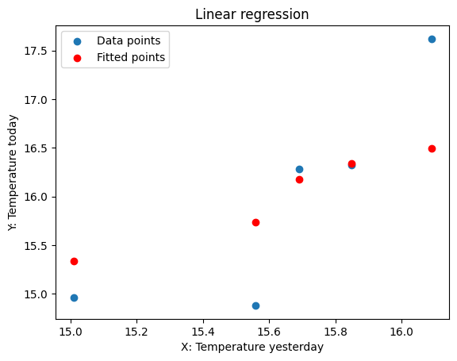
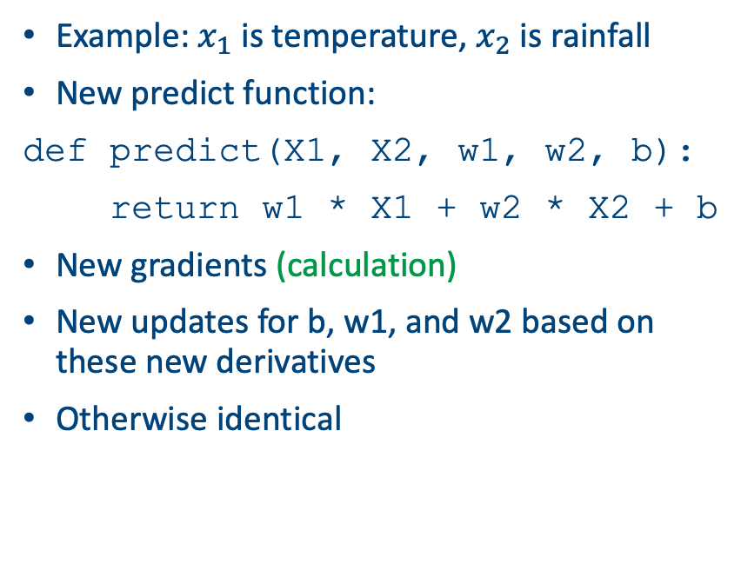
Extension 1: multiple features
Example: $x_{1}$ is temperature, $x_{2}$ is rainfall
New predict function:
def predict(X1, X2, w1, w2, b):
return w1 * X1 + w2 * X2 + b
New gradients (calculation)
New updates for b, w1, and w2 based on these new derivatives
Otherwise identical

Slide 35
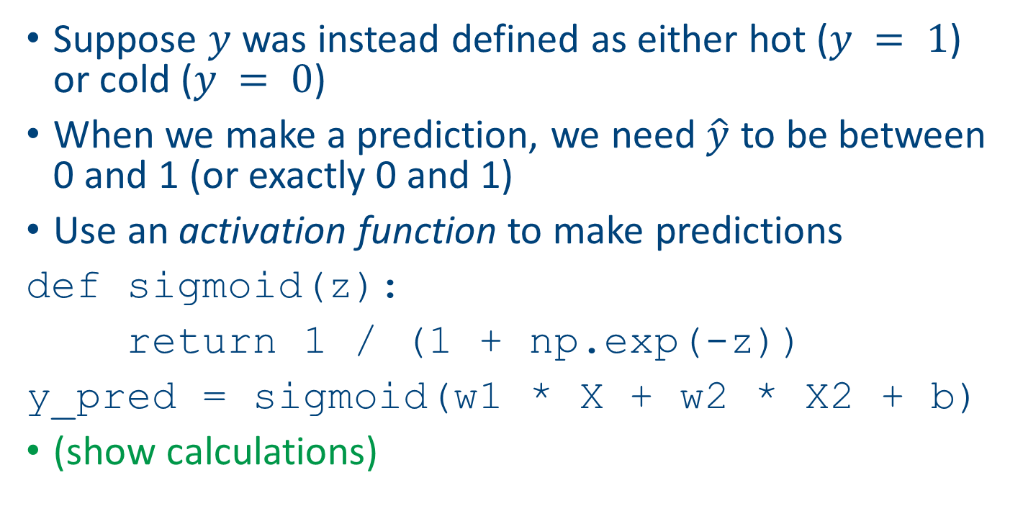
Extension 2: classification
Suppose $y$ was instead defined as either hot ($y = 1$) or cold ($y = 0$)
When we make a prediction, we need $\hat{y}$ to be between 0 and 1 (or exactly 0 and 1)
Use an activation function to make predictions
def sigmoid(z):
return 1 / (1 + np.exp(-z))
y_pred = sigmoid(w1 * X + w2 * X2 + b)
(show calculations)

Slide 36
New loss function
def binary_cross_entropy(y_true, y_pred):
epsilon = 1e-15
y_pred = np.clip(y_pred, epsilon, 1 - epsilon)
return -np.mean(y_true * np.log(y_pred) + (1 - y_true) * np.log(1 - y_pred))
The clipping and the epsilon avoid us from creating log(0)
When y_true = 1 it’s just the log of the prediction, and when y_true = 0 it’s the log of 1 minus the prediction
Averaged over all the data points

Slide 37
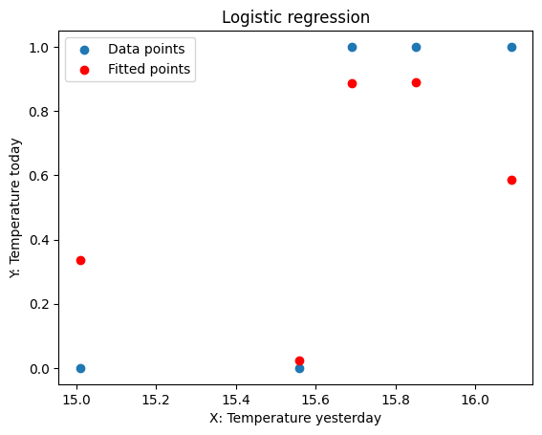
Results
Epoch 0, Loss: 0.6931, w1: 0.0013, w2: -0.0127, b: -0.0001
Epoch 10, Loss: 0.6091, w1: 0.0146, w2: -0.1398, b: -0.0014
Epoch 20, Loss: 0.5366, w1: 0.0279, w2: -0.2670, b: -0.0026
Epoch 30, Loss: 0.4747, w1: 0.0412, w2: -0.3941, b: -0.0038
Epoch 40, Loss: 0.4223, w1: 0.0545, w2: -0.5212, b: -0.0051
Epoch 50, Loss: 0.3782, w1: 0.0678, w2: -0.6483, b: -0.0063
Epoch 60, Loss: 0.3409, w1: 0.0810, w2: -0.7755, b: -0.0075
Epoch 70, Loss: 0.3094, w1: 0.0943, w2: -0.9026, b: -0.0088
Epoch 80, Loss: 0.2826, w1: 0.1076, w2: -1.0297, b: -0.0100
Epoch 90, Loss: 0.2597, w1: 0.1209, w2: -1.1568, b: -0.0112

Slide 38
Summary
Key ingredients: loss function, prediction function, gradients
Loop through using gradient descent to optimise the weights and the biases
Run over epochs until the parameters converge
Use the final values as your final model to predict
All code available to re-create these plots in the Github repository

